Slide 1
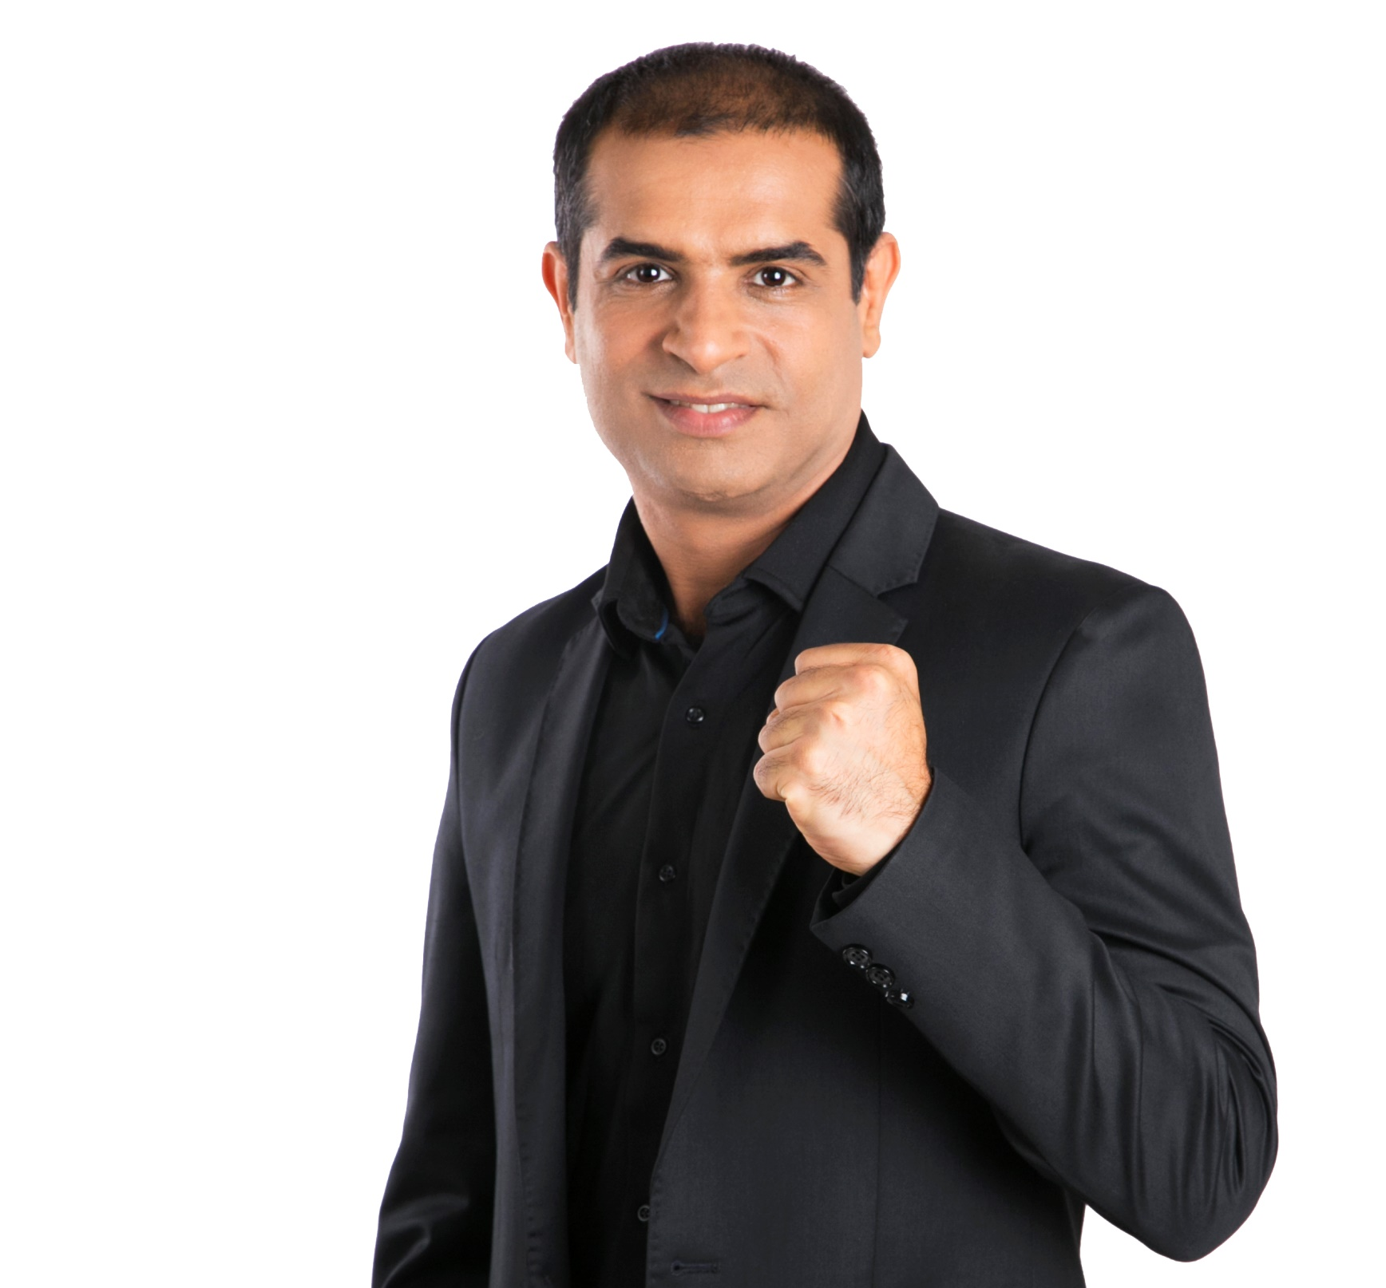
SELF ESTEEM
How to Improve
1 Simple Step
-Mitesh Khatri

